Slide 1
Note:
Class
Data Member OR Variable
Member Function OR Function OR Method OR Sub-Routine

Slide 2
1. Class & Objects
In Java, a class is a blueprint for creating objects. It defines a datatype by bundling data (attributes) and methods (functions) that operate on the data into a single unit.
Class:
Definition: A class is defined using the class keyword followed by the class name and a body enclosed in curly braces.
Components: It typically includes fields (variables) and methods to define the behavior and state of the objects created from the class.

Slide 3
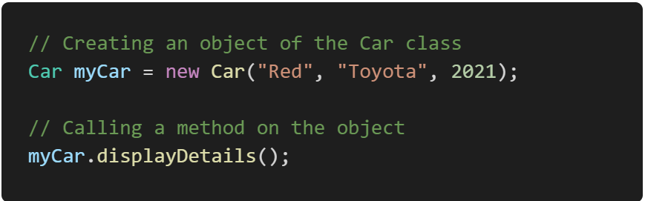
Object
Definition: An object is an instance of a class. When a class is instantiated, memory is allocated for the object, and the constructor of the class is called to initialize the object.
Creation: Objects are created using the new keyword.
Create and use an object of the Car class:

Slide 4
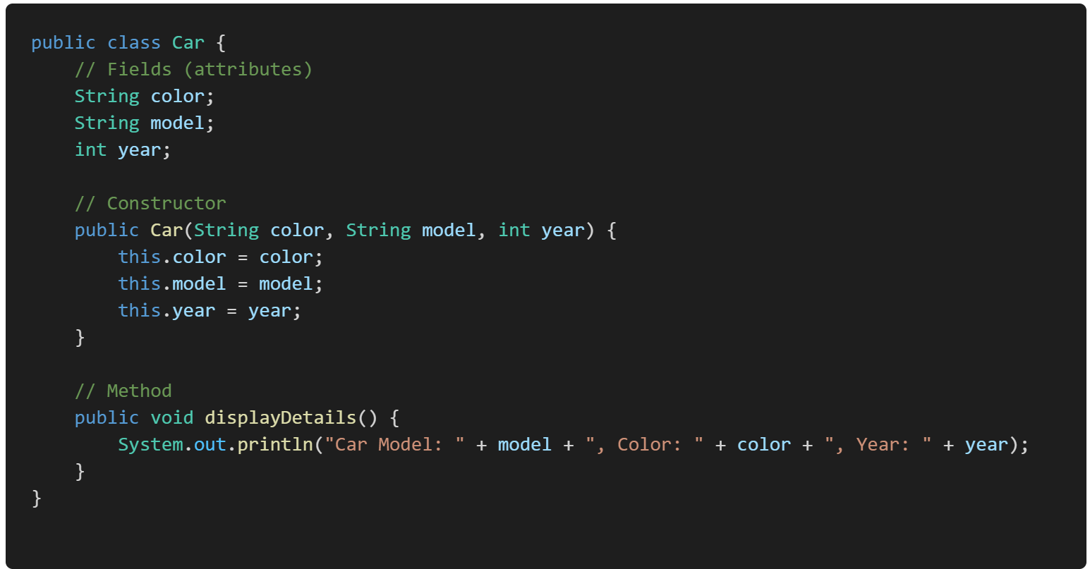
Example:

Slide 5
Methods and Constructors:

Slide 6
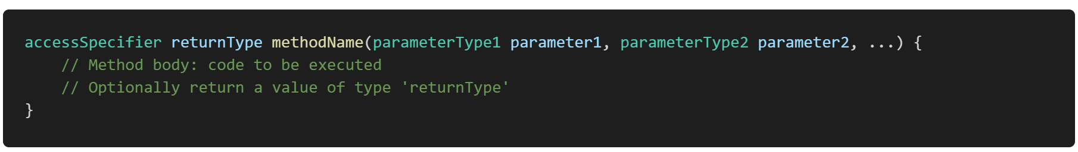
Method:
In Java, a method is a block of code that performs a specific task and can be executed when called upon. Methods are used to define the behavior of objects, perform operations, and structure the code in a modular and reusable way.
Components of a Method
Return Type: Specifies the type of value the method returns. If the method does not return a value, the return type is void.
Method Name: The name of the method, which is used to call it. Method names should be meaningful and follow camelCase convention.
Parameters (optional): A list of variables that the method can accept as input. Each parameter is defined by a type and a name. Parameters are optional; a method can have zero or more parameters.
Method Body: The block of code enclosed in curly braces {} that defines what the method does
Return Statement (optional): If the method has a return type other than void, it must include a return statement to return a value.

Slide 7
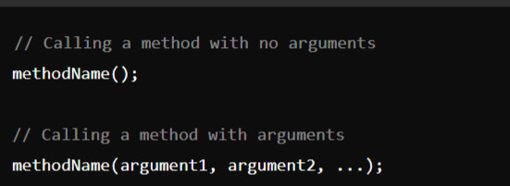
Calling a Method:
To call a method in Java, you use the method name followed by parentheses, which may include arguments if the method requires parameters. Methods can be called from within other methods or from different classes, depending on their visibility (access specifier).
Syntax:

Slide 8
Parameter Passing :
Java supports two types of parameter passing:
Pass by Value (the only parameter passing method in Java)
Pass by Reference (not directly supported in Java for objects, but reference variables are passed by value)

Slide 9
Constructor:
A constructor in Java is a special method that is used to initialize objects. The constructor is called automatically when an object of a class is created. Constructors are important because they allow you to set initial values for object attributes and prepare the object for use.
Key Characteristics of a Constructor:
Name: The constructor's name must be the same as the class name.
No Return Type: Constructors do not have a return type, not even void.
Called Automatically: The constructor is called automatically when an object is created using the new keyword.

Slide 10
Types of Constructors :
Default Constructor
Parameterized Constructor

Slide 11
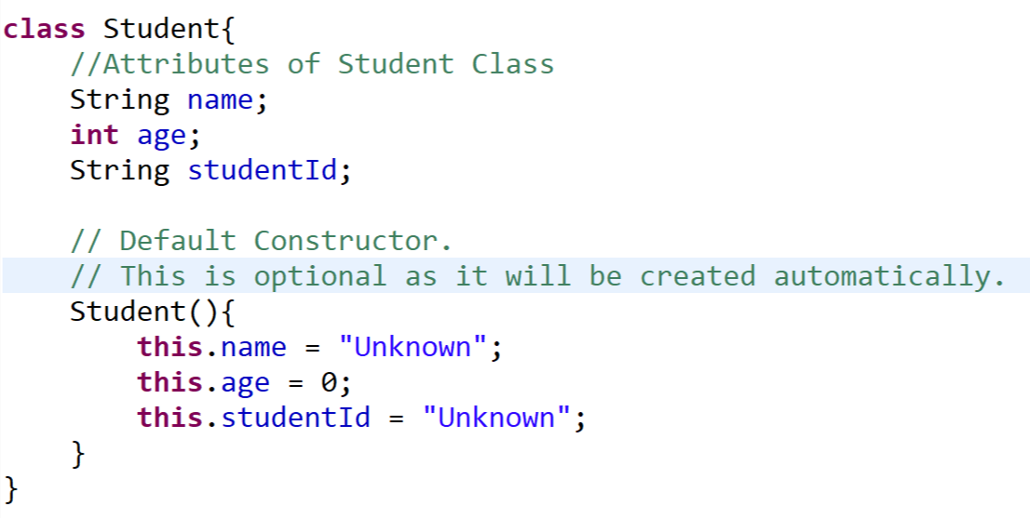
1. Default Constructor
A default constructor is a constructor that does not take any arguments. If you do not explicitly define a constructor in your class, the Java compiler provides a default constructor that initializes all member variables to their default values (e.g., 0, null, false).
Example:

Slide 12
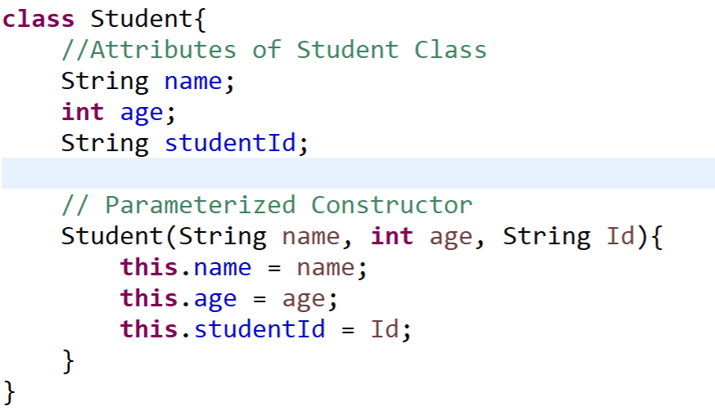
2. Parameterized Constructor:
A parameterized constructor is a constructor that takes one or more arguments. These parameters allow you to pass specific values when creating an object, enabling customized initialization.
Example:

Slide 13
this Reference:
In Java, this keyword is a reference to the current object, the object whose method or constructor is being called. It is a powerful and versatile tool that serves several important purposes in object-oriented programming.
Example:

Slide 19
Module-1: OOPS CONCEPTS AND JAVA PROGRAMMING:
OOP concepts: Classes and objects, data abstraction, encapsulation, inheritance, benefits of inheritance, polymorphism, procedural and object oriented programming paradigm.
Java programming: History of java, comments, data types, variables, constants, scope and life time of variables, operators, operator hierarchy, expressions, type conversion and casting, enumerated types, control flow statements, jump statements, simple java stand alone programs, arrays, console input and output, formatting output, constructors, methods, parameter passing, static fields and methods, access control, this reference, overloading methods and constructors, recursion, garbage collection, exploring string class.

